Slide 1


SMART Tool
Project Interface Guide

Slide 2
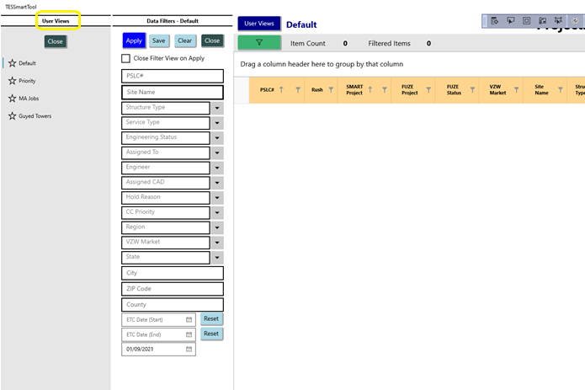
User Views
User views are customizable data query and grid layout configurations that can be created, named, and saved
Create a copy of an existing user view by right-clicking on a user view and then selecting Copy
Rename or delete user views from the same right-click menu
Clicking the Default user view will auto-open the Data Filters pane
Clicking any non-Default user view will auto-close both the User Views and the Data Filters panes and will also execute the saved data query for the selected user view

Slide 3
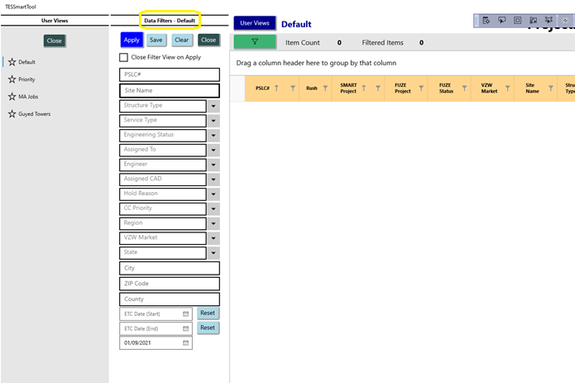
Data Filters
Data filters control the rows of data that are returned from the database and made available for viewing in the project data grid
Create data filters by selecting attribute values in the attribute value selection boxes
Execute the current view’s configured data filters by clicking the Apply button in the Data Filters pane
Save the current data filters into the selected user view by clicking the Save button in the Data Filters pane
Clicking the Apply button in the Default user view will keep the Data Filters pane open unless the Close Filter View on Apply checkbox is selected
Clicking the Apply button on a non-Default user view will auto-close the Data Filters pane

Slide 4
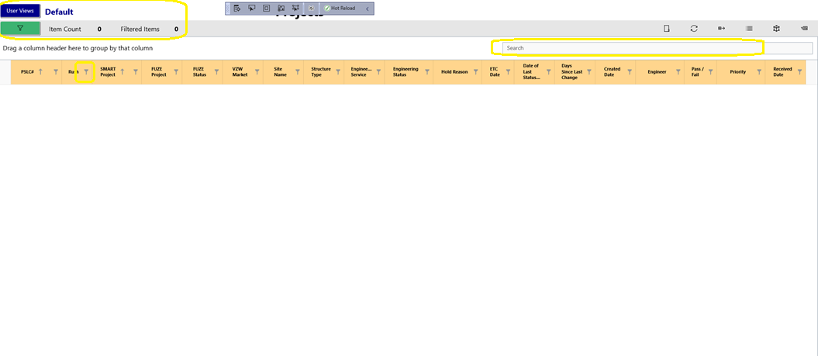
Data Grid
The data grid displays the data records that are returned from the current data query minus the records that are filtered out from the column header filters in the grid
Column header filters at the top of each data grid column may be applied to the result of the data query by clicking on the filter icon in the column header
The Item count shows the total number of data records returned from the current data query
The Filtered Items shows the number of records after column header filtering is applied
Open the User Views pane by clicking the User Views button
The current selected user view name is displayed to the right of the User Views button
Open the Data Filters pane by clicking the green data filter button underneath the User Views button
The Search interface on the data grid applies a basic string match filter criteria to the returned data records across all the visible columns
Sort data grid columns by clicking a column header: once for ascending, twice for descending, and three times to cancel sorting
Column sort states are saved in the current user view

Slide 5
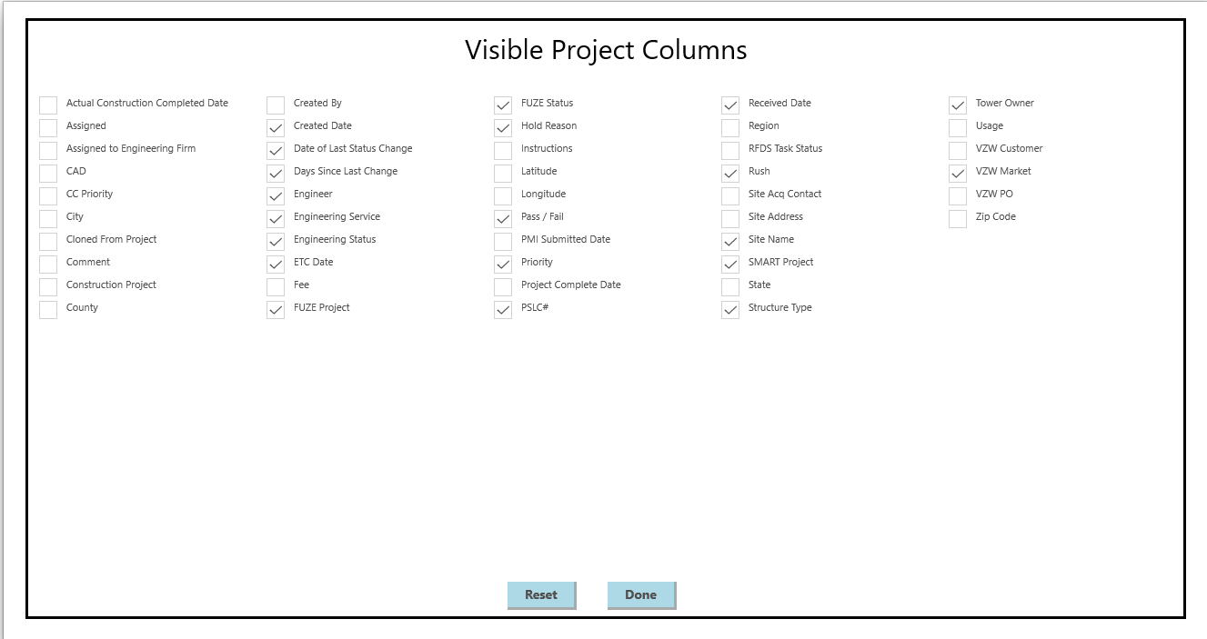
Data Grid – Hiding and Showing Columns
Right-click on the data grid to access the Visible Columns menu option
The Visible Project Columns pane shows all columns available in the data grid
Hide or show a column by clicking the checkbox for that column to toggle the column’s visibility
The Done button applies the selections to the data grid
The Reset button enables all the columns in the data grid
The state of the visible column selections are saved in the current user view

Slide 6
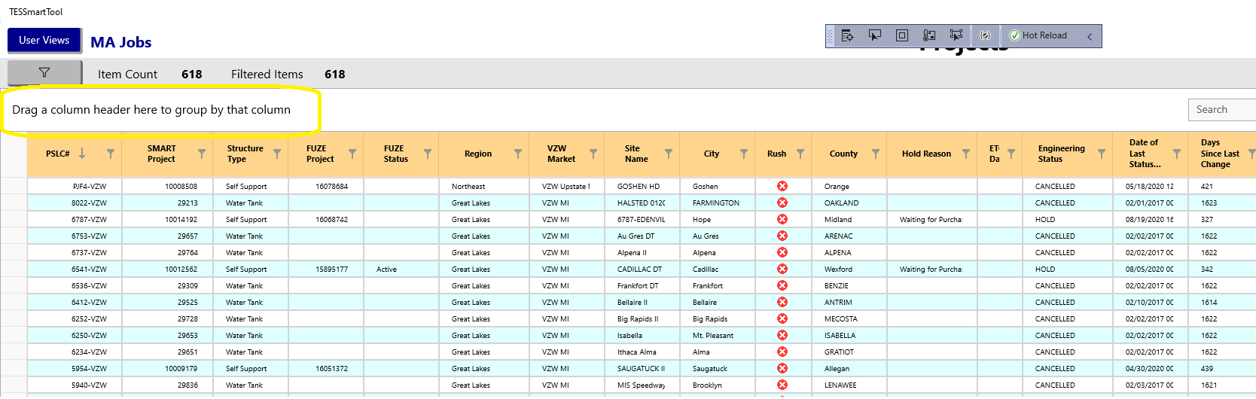
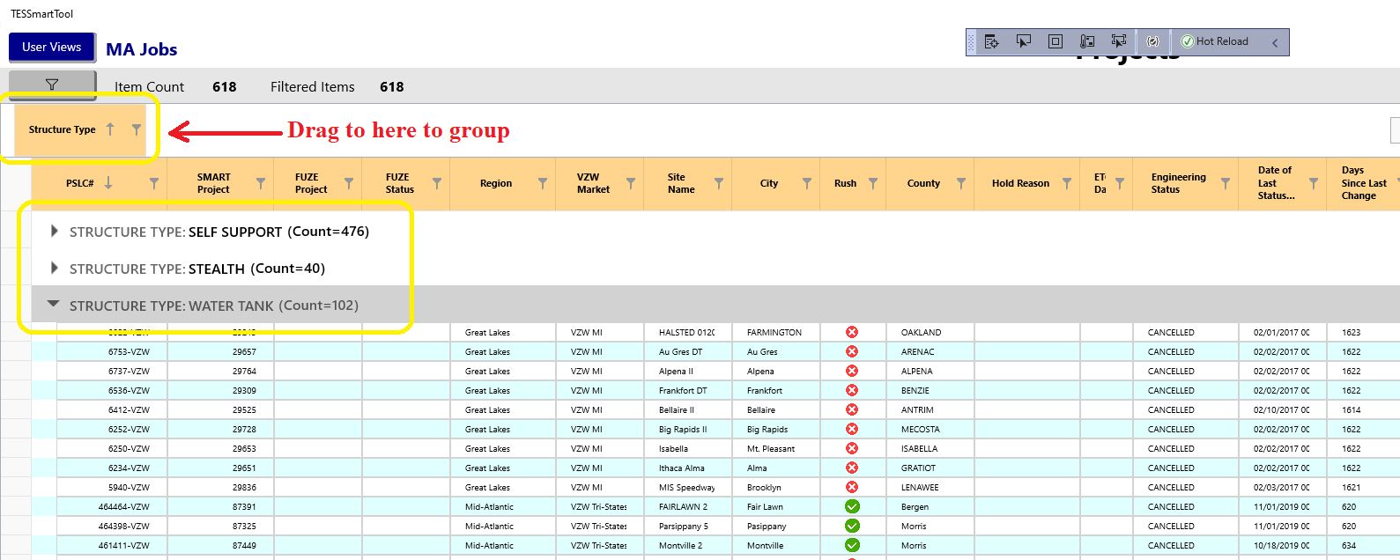
Data Grid – Column Grouping
Group rows by dragging a column header into the Group By section above the column headers
Grouped rows will collapse into grouped collections that all have the same grouped column value(s)
Click on the grouped collection expander to see the rows in that group
Cancel grouping for a column by dragging it back into the visible column header section

